Slide 1
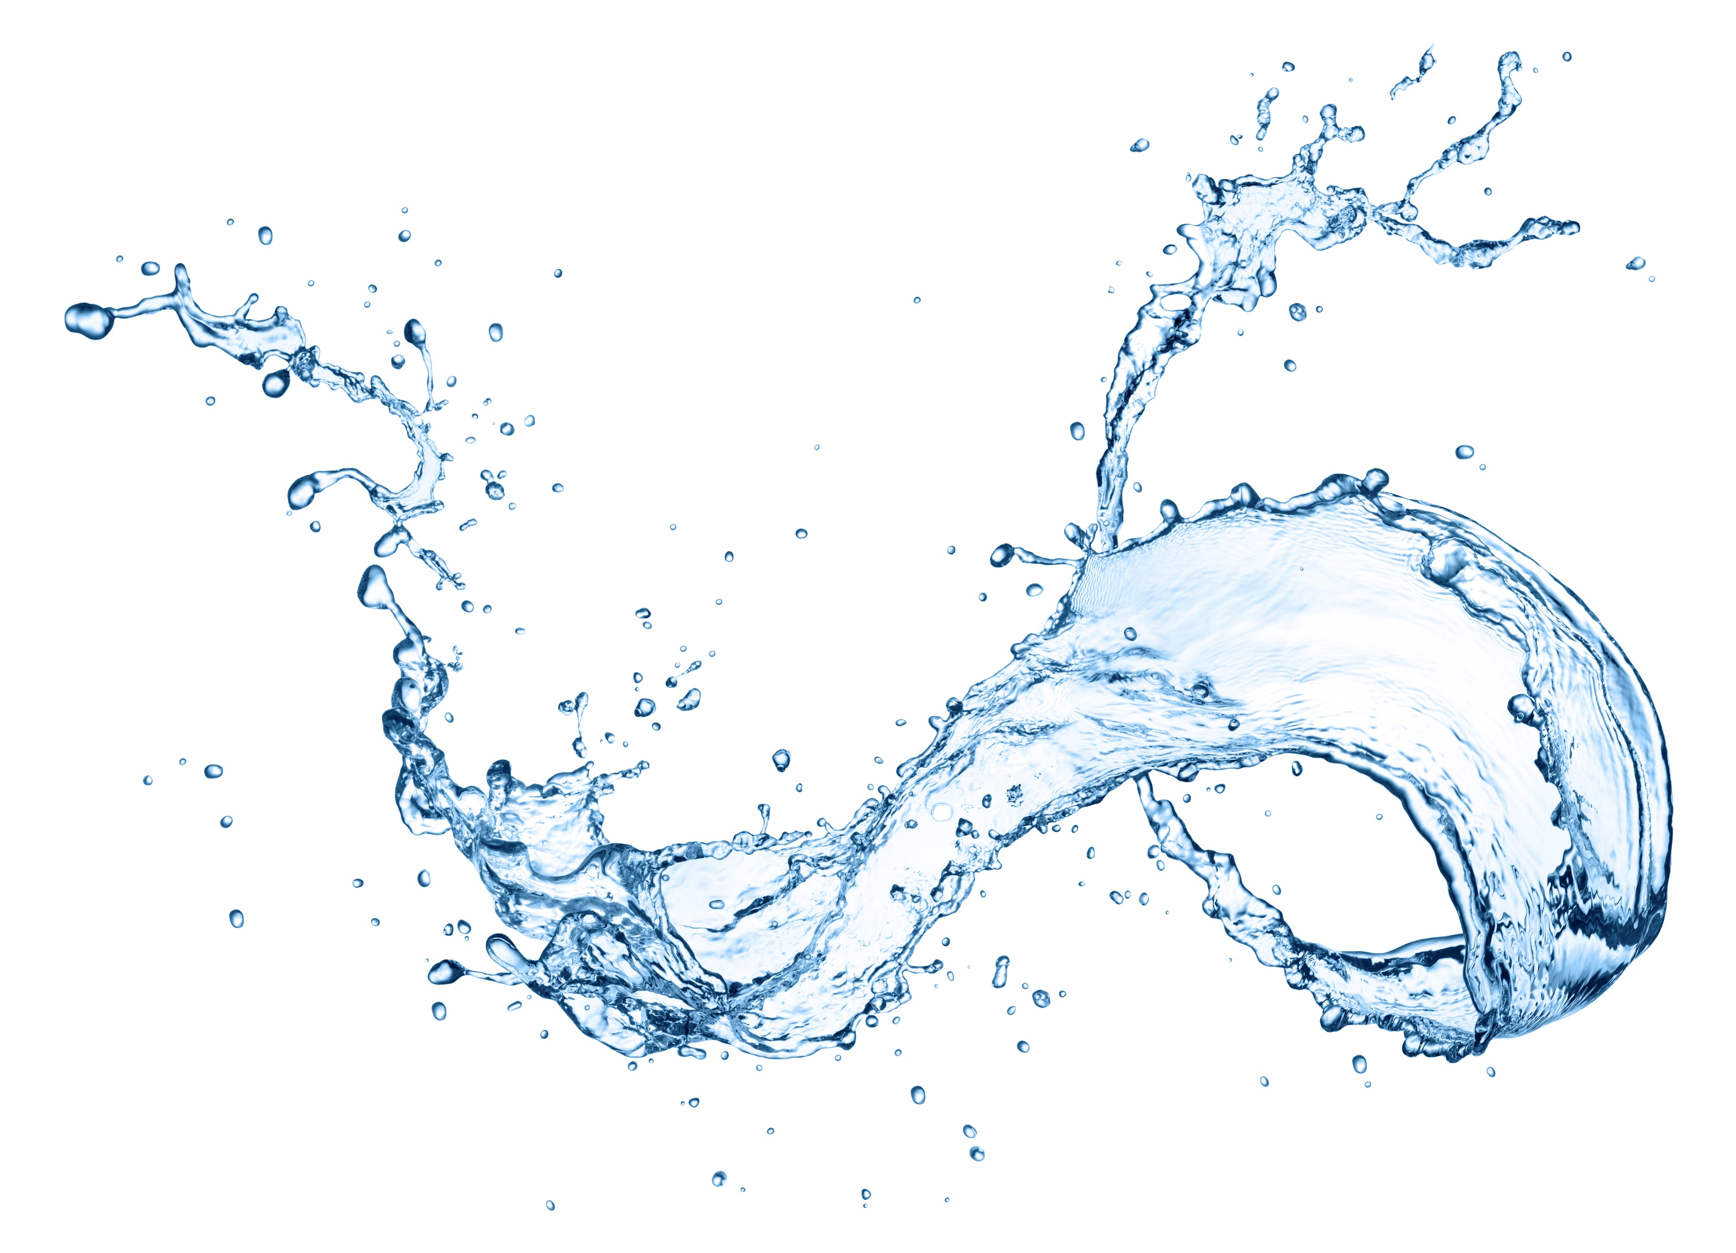
Dental Waterline Treatment Solutions

Slide 2
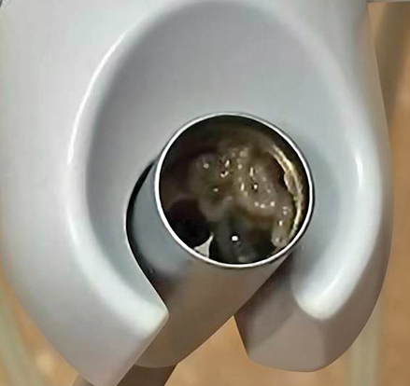
The Bacteria Problem
Biofilm coat the inside of a dental waterline and increase the baseline Colony Forming Unit (CFU) count to greater than the CDC drinking water standard.
Without continuous treatment, elevated CFU counts will give way to biofilm formation and the persistent issues associated with it.
ADA, CDC and EPA water quality standard <500 CFU/ml HPC purity

Slide 3
The Bacteria Problem

Slide 4
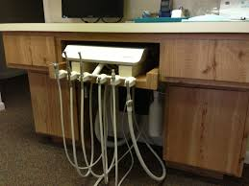
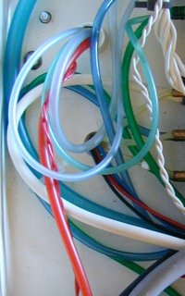
Why is this a concern in DUWLs?
Dental Waterlines
Small bore tubing
Very slow and infrequent water flow
Room temperature conditions
Porous material for bacteria to cling to
Irrigation during dental procedures produces aerosols
Consistent flow of dissolved nutrients

Slide 5
The Organization for Safety, Asepsis and Prevention (OSAP) Recommendations
Follow CDC Guidelines and manufacturer instructions for dental treatment.
Isolate dental water systems from municipal water supplies using:
Independent water reservoirs
Water treatment devices
Point of use filtration
Sterile water delivery systems for oral surgery
Use water of known microbiological quality in water reservoirs
For units currently supplied by municipal water:
Shock treat the lines to remove existing biofilm or;
Replace biofilm contaminated lines with new tubing
Follow manufacturer instructions for monitoring
Use drinking water standard testing methods

Slide 6
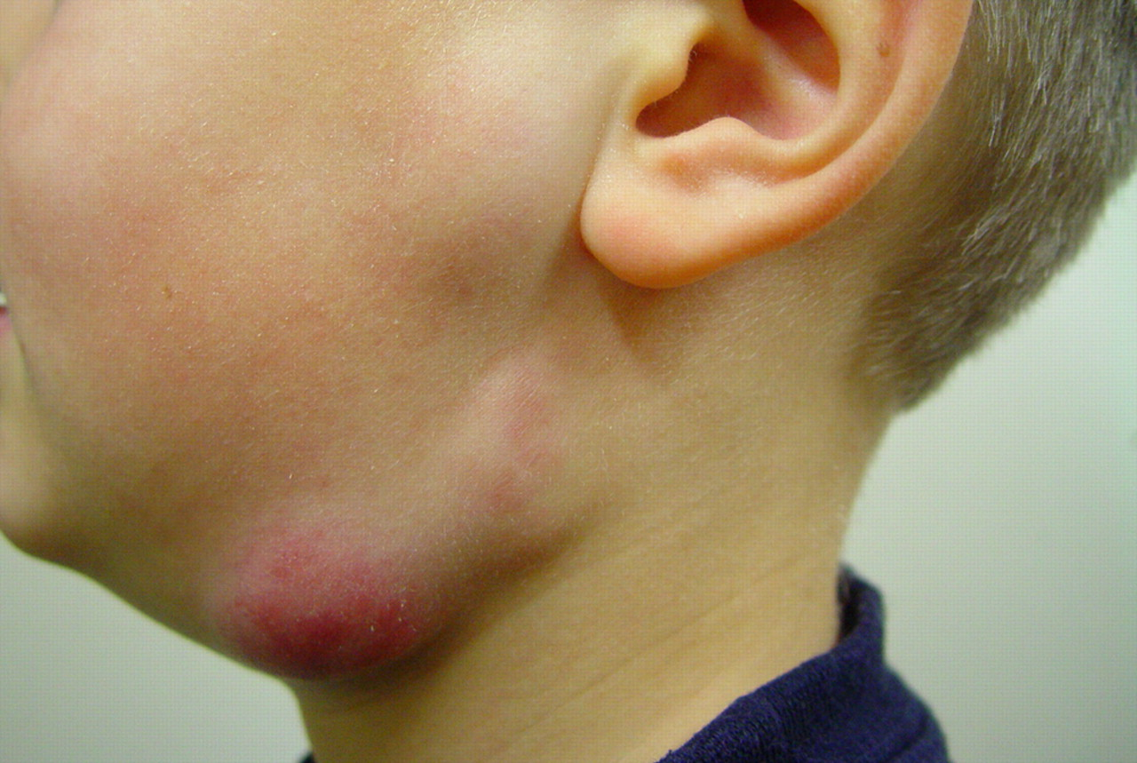
Waterline in the News
2015 – Mycobacterium Outbreak (Jonesboro, Georgia)
20 pediatric patients undergoing pulpotomies were infected.
2016 – Mycobacterium Outbreak (Orange County, California)
73 pediatric patients undergoing pulpotomies were infected.
2018 – Whistleblower in Virginia calls out dental practice for waterline negligence
Pediatric patient’s mother blows the whistle on potential negligent waterline infection control practices.
2018 – Patricia A. Murray Dental Corp. v. Dentsply International, Inc
Dismissed based on the fact that the “plaintiffs were aware of the biofilm risk posed by Cavitron usage, but they purchased and used it anyway.”

Slide 7
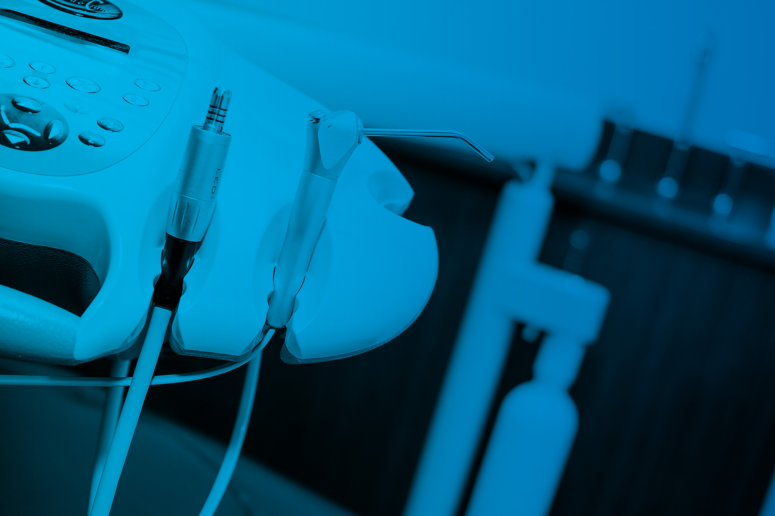
Waterline treatment made easy and reliable
Sterisil’s mission is to ensure dental water compliance and patient safety by educating protocols and providing safe, simple products.

Slide 8
Sterisil®- A compliance company driven by three interdependent factors…
Protocols
Pioneering waterline protocols that can be consistently observed, measurably effective, and consistent with product labeling.
Products
Developing products capable of delivering effluent handpiece water treated to ≤10 CFU/ml HPC purity while remaining safe for patients, staff, and equipment.
Compliance
Helping dental professionals provide the safest possible dental care through education, treatment products, and waterline testing.

Slide 9
Shock
Formulated to eliminate bacteria to compliant levels.
Should be compatible with maintenance treatments.
Intermittent shocking cycles based on product labeling.
Maintenance
Continuous/residual treatment maintains bacteria to compliant levels so long as protocols are followed.
Treated water should be continuously present for optimal results.
DUWL Processes
Periodic shocking reduces microbial contamination to compliant levels.
Continuous/residual treatments control bacteria and biofilm growth during procedures using non-toxic antimicrobial chemicals.
BOTH treatments are necessary to maintain bacterial and biofilm contamination levels below 500 CFU/ml.
What are the product’s instructions for purging & emptying bottles overnight?

Slide 10
Sterisil® Straw V2 Intro

Slide 11
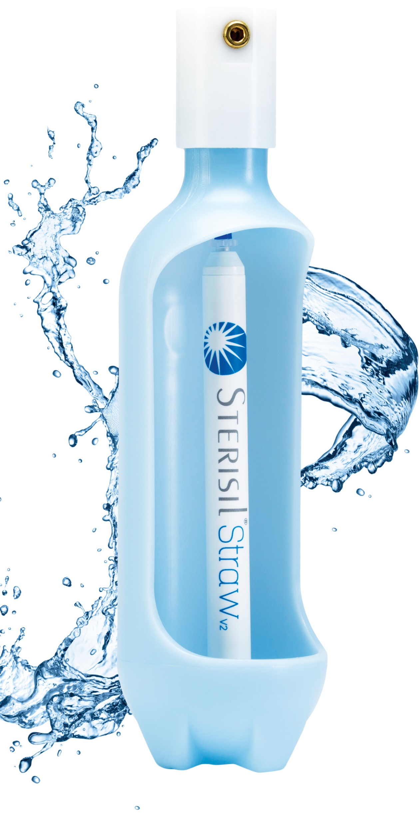
Sterisil® Straw V2
Designed to deliver
Upgrades
Reengineered for ease of use
Installation and replacement only takes a minute with the new Luer Lock fitting
Tapered top cap prevents snags when removing the bottle
Recessed bottom cap improves water flow
Highlights
365 days of waterline treatment
Built in shock treatment
Compatible with any size bottle
Two formulations available: Municipal and Distilled

Slide 12
How to Install

Slide 13
Shock Treatment The Straw automatically produces a shock treatment after the initial installation.
To Shock
Slowly purge the waterlines attached to the dental unit into a cup until you see the light blue color.
Allow lines to remain unused for a minimum of 12 hours. For best results, allow Shock to remain in the line(s) over the weekend.

Slide 14
Scheduled Protocols
Daily
Leave water bottles on the chairs and water in the lines at the end of the day to continually release the residual treatment.
Monthly
With the Straw on the chair, clean with Citrisil™ per the tablet IFU if you do not have an Antimicrobial Bottle.
Weekly
Remove bottle and top off the water.
Ensure the Luer lock fitting is pushed completely into the pickup tube and threaded tightly into the Straw.
Yearly
Replace the Straw with a new Straw and follow Shock treatment instructions.

Slide 15
As Needed Protocols
Chair dormant more than 2 weeks
Remove the bottle and purge the waterlines and allow them to air dry. The Straw can be left on the pick-up tube with the bottle reattached.
Before using the chair, shock with Citrisil™shock tablet.
Chair fails a bacteria test
Sterisil recommends shocking with Citrisil shock tablet and retesting.
If a chair fails a second time, contact Sterisil customer support at 719-622-7200 or support@sterisil.com.

