Slide 1
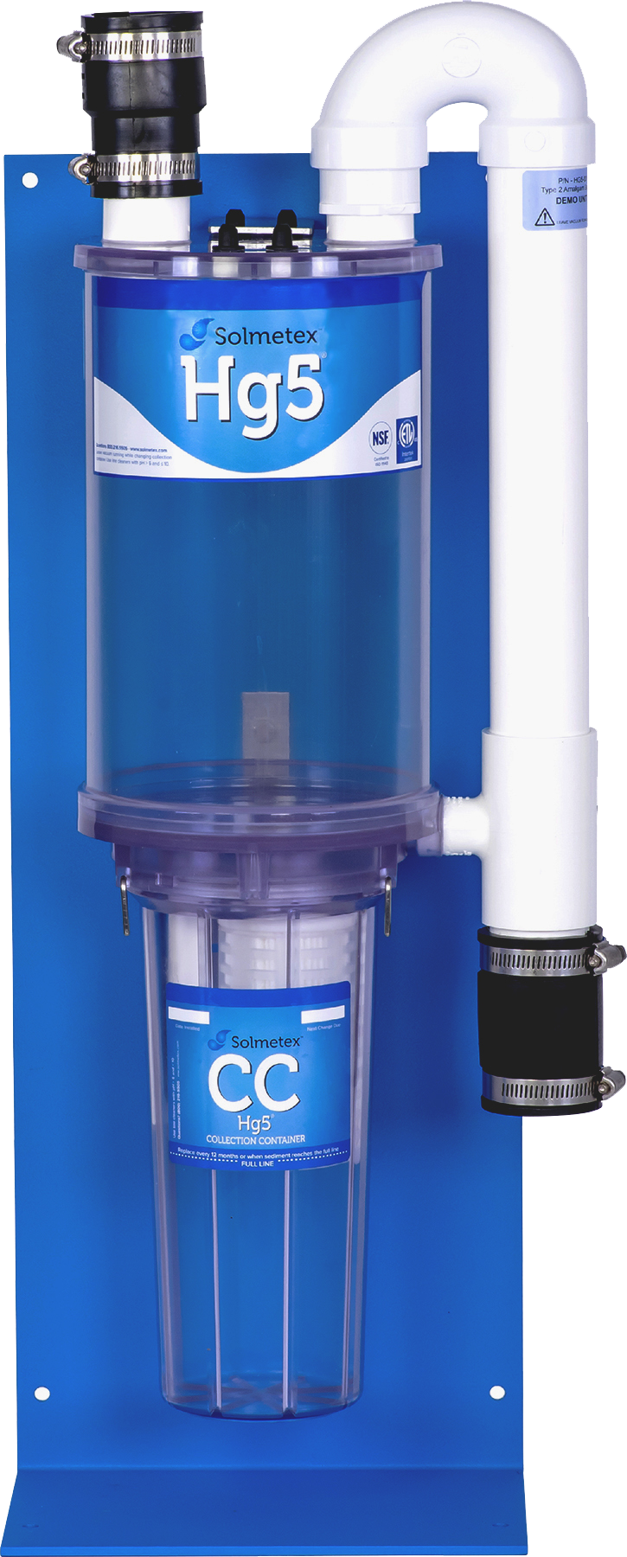
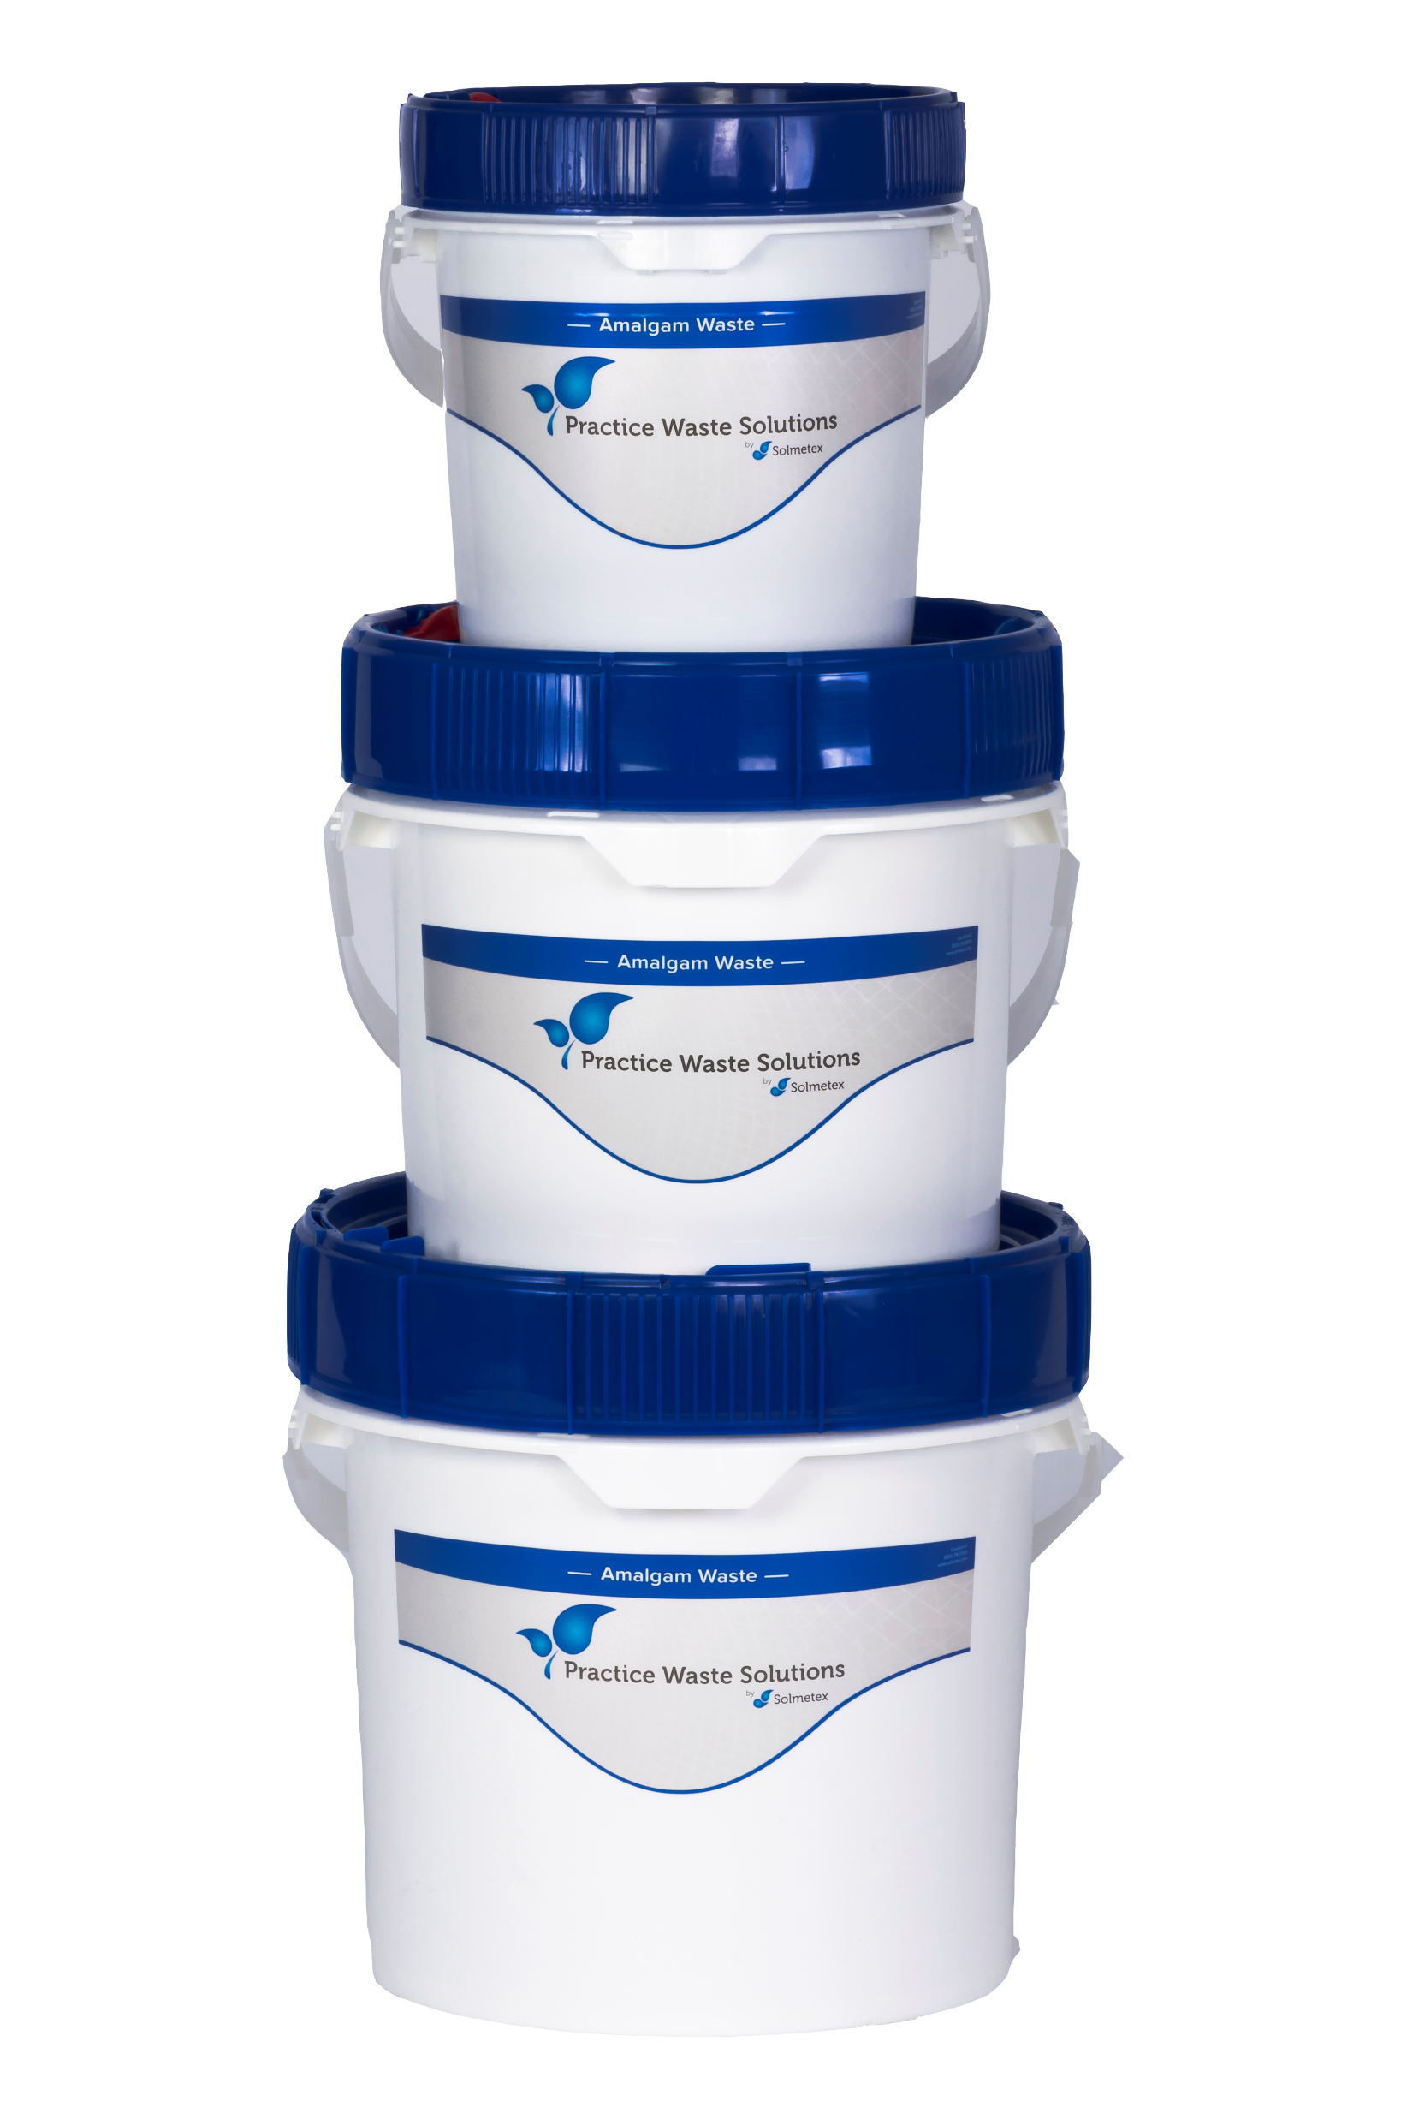
Is your practice ready for the new EPA regulation regarding amalgam waste?
Learn More & Special Offer

