Slide 1


Metro Wastewater Reclamation District
Dental Amalgam Control Program
Implementation & Training
Slide 1
Notes:
This template can be used as a starter file for presenting training materials in a group setting.
Sections
Right-click on a slide to add sections. Sections can help to organize your slides or facilitate collaboration between multiple authors.
Notes
Use the Notes section for delivery notes or to provide additional details for the audience. View these notes in Presentation View during your presentation.
Keep in mind the font size (important for accessibility, visibility, videotaping, and online production)
Coordinated colors
Pay particular attention to the graphs, charts, and text boxes.
Consider that attendees will print in black and white or grayscale. Run a test print to make sure your colors work when printed in pure black and white and grayscale.
Graphics, tables, and graphs
Keep it simple: If possible, use consistent, non-distracting styles and colors.
Label all graphs and tables.

Slide 2
Outline
Dental Amalgam Control Program Overview
Best Management Practices (BMPs)
Amalgam Separator Installation & Certification
Operations and Maintenance (O&M) Plan
Record Keeping Requirements
Annual Requirements and Inspections
Slide 2
Notes:
Give a brief overview of the presentation. Describe the major focus of the presentation and why it is important.
Introduce each of the major topics.
To provide a road map for the audience, you can repeat this Overview slide throughout the presentation, highlighting the particular topic you will discuss next.

Slide 3
Dental Amalgam Control Program
Overview
Slide 3
Notes:
Use a section header for each of the topics, so there is a clear transition to the audience.

Slide 4

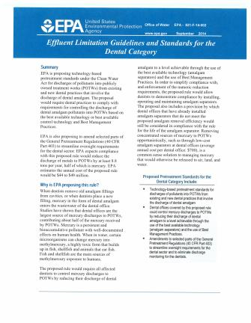
Dental Amalgam Control Program Overview
On August 19, 2014, the EPA approved changes to the Metro District’s Rules and Regulations to add a Dental Amalgam Control Program to regulate all dental facilities within the Metro District’s service area.
  In the summer of 2016, the EPA’s Proposed Dental Effluent Guidelines are expected to be finalized. This ruling may supplement the Metro District’s existing Dental Amalgam Control Program, as this ruling will apply to all existing programs and dental facilities across the nation.
Dental Amalgam Control Program Overview
Slide 4

Slide 5
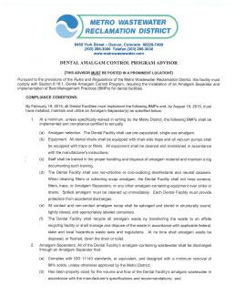
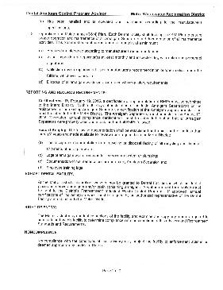
Dental Amalgam Control Program Overview
(Continued)
  The Metro District’s Dental Amalgam Control Program Advisor must be posted in a prominent location!
Dental Amalgam Control Program Overview
Slide 5

Slide 6
Best Management Practices (BMPs)
Metro District Rules and Regulations 6.16
Slide 6
Notes:
Use a section header for each of the topics, so there is a clear transition to the audience.

Slide 7
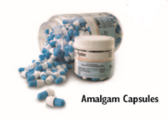
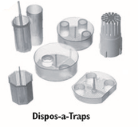
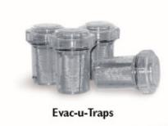
Best Management Practices (BMPs)
  Best Management Practices (BMPs) are control measures required of the dental facility to prevent or control the disposal of mercury and other metals in the form of restorative amalgams.
  Use precapsulated, single-use amalgam. Bulk mercury must not be used, and any remaining bulk mercury must be appropriately recycled.
  All dental chairs must be equipped with chair-side traps, and all vacuum pumps equipped with traps or filters. All equipment shall be cleaned and maintained in accordance with the manufacturer’s instructions. Disposable chair-side traps should be placed in a scrap amalgam collection container, and the contents of re-usable chair-side traps should be emptied in a scrap amalgam collection container for recycling.
Best Management Practices (BMPs)
Slide 7
Notes:
Keep it brief. Make your text as brief as possible to maintain a larger font size.

Slide 8
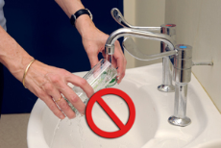
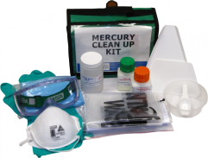
Best Management Practices (BMPs)
(Continued)
  Do not rinse screens, filters, traps, amalgam separators or any other amalgam-containing equipment over sinks or drains.
  In the event that amalgam is spilled, proper cleaning and disposal procedures must be used. A mercury spill kit can be utilized for such occurrences. Spilled amalgam must be cleaned up immediately. Each dental facility must provide protection from accidental discharges.
  Dental staff should be trained in the proper handling and disposal of amalgam material and maintain a log documenting such training.
  (Example Staff Training Log on next slide.)
Best Management Practices (BMPs)
Slide 8
Notes:
Keep it brief. Make your text as brief as possible to maintain a larger font size.

Slide 9
Best Management Practices (BMPs)
Example Staff Training Log
(Handling and disposal of amalgam material)
Training Detail | Training Date | Employee Name | Employee Signature
Dr. Jones demonstrated proper handling of new amalgam separator and showed how to remove and replace full amalgam separator cartridges. | 03/15/15 | Jane Doe | _________________
“ | 03/15/15 | John Doe | _________________
“ | 03/22/15 | Pat Smith | _________________
Demonstration of chair-side trap maintenance by Jane Doe | 04/10/15 | John Doe | _________________
“ | 04/10/15 | Pat Smith | _________________
Best Management Practices (BMPs)
Slide 9
Notes:
Keep it brief. Make your text as brief as possible to maintain a larger font size.

Slide 10
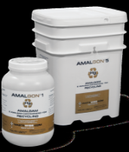
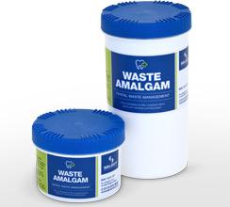
Best Management Practices (BMPs)
(Continued)
All contact and non-contact amalgam scrap must be salvaged and stored in structurally sound, tightly closed and appropriately labeled containers.
Recycle ALL amalgam waste by transferring waste to an offsite recycling facility for recycling of mercury or manage and dispose of the waste in accordance with applicable federal, state and local hazardous waste laws and regulations.
At no time should amalgam waste be disposed of or flushed down the drain or toilet!
Best Management Practices (BMPs)
Slide 10
Notes:
Keep it brief. Make your text as brief as possible to maintain a larger font size.

Slide 11

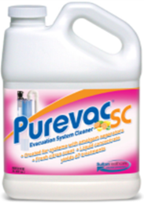
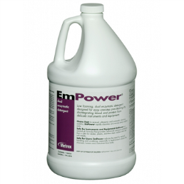


Best Management Practices (BMPs)
(Continued)
Only use non-chlorine, non-oxidizing disinfectants and neutral cleaners. Chlorinated, oxidizing cleaners will cause mercury to dissolve and pass through the amalgam separator system.
Examples of non-chlorine,
non-oxidizing disinfectants
Slide 11

Slide 12

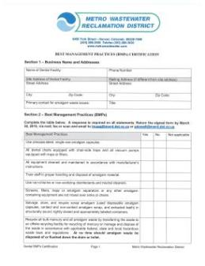
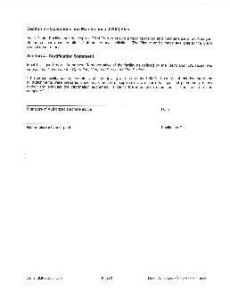
Best Management Practices (BMPs)
(Continued)
All dental facilities must certify annually (by December 31), that all BMPs were followed. All certifications must be signed by an authorized representative of the dental facility.
Best Management Practices (BMPs)
Slide 12
Notes:
Keep it brief. Make your text as brief as possible to maintain a larger font size.

Slide 13
Quiz #1
Slide 13
Notes:
Use a section header for each of the topics, so there is a clear transition to the audience.

Slide 14
Quiz #1
  All contact and non-contact amalgam scrap must be salvaged and stored in:
    Brown paper bags.
    Structurally sound, tightly closed and appropriately labeled containers.
    Fish bowls.
  All amalgam waste should be disposed of by:
    Transferring waste to an off-site mercury recycling facility.
    Disposing of the waste in accordance with applicable federal, state and local hazardous waste laws and regulations.
    All of the above.
  It is okay to flush amalgam waste down the drain or toilet:
    True
    False
Quiz #1
Slide 14
Notes:
Keep it brief. Make your text as brief as possible to maintain a larger font size.

Slide 15
Quiz #1
(Continued)
  How often should BMP Certifications be submitted to the Metro District?
    Monthly
    Annually
    Quarterly
  What should your office do with the Dental Amalgam Control Program Advisor?
    Post it in a prominent location
    Throw it away
    Mail it back to the Metro District
  Dental facilities should only use the following types of cleaners:
    Only bleach and chlorine.
    Non-chlorine or non-oxidizing disinfectants and neutral cleaners.
    None – A little dirt never hurt anyone.
Quiz #1
Slide 15
Notes:
Keep it brief. Make your text as brief as possible to maintain a larger font size.

Slide 16
Quiz #1
(Continued)
  All dental chairs must be equipped with chair-side traps, and all vacuum pumps equipped with traps or filters. This equipment must be cleaned and maintained:
    In accordance with the manufacturer’s instructions.
    By staff properly trained to handle disposal of amalgam material.
    All of the above.
Quiz #1
Slide 16
Notes:
Keep it brief. Make your text as brief as possible to maintain a larger font size.

Slide 17
Amalgam Separator Installation & Certification
Metro District Rules and Regulations 6.16.1(2)(a)(b)(c)
Slide 17
Notes:
Use a section header for each of the topics, so there is a clear transition to the audience.

Slide 18
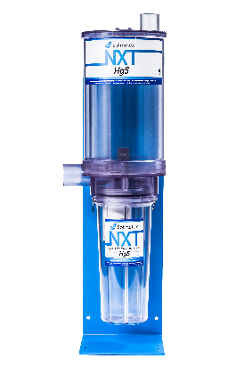
Amalgam Separator
Installation & Certification
  All amalgam-containing wastewater must be discharged through an amalgam separator.
  Amalgam separators must comply with ISO 11143 standards, or equivalent, and designed with a minimum removal of 98% solids, unless otherwise approved by the Metro District.
  Amalgam separators must be properly sized for the volume and flow of the dental facility’s amalgam wastewater in accordance with the manufacturer’s specifications and recommendations.
Amalgam Separator Installation & Certification
Slide 18

Slide 19
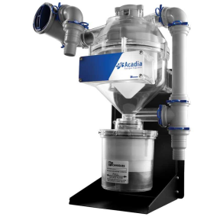
Amalgam Separator
Installation & Certification
(Continued)
  Amalgam separators must be installed, operated and maintained according to the manufacturer’s specifications.
  A certification statement must be submitted to the Metro District within 30 days of the installation or replacement of an amalgam separator. Thereafter, compliance certifications must be submitted annually certifying the separator has been properly used and maintained.
  All certifications must be signed by an authorized representative of the dental facility.
Amalgam Separator Installation & Certification
Slide 19

Slide 20
Operations and Maintenance Plan
Metro District Rules and Regulations 6.16.1(3)
Slide 20
Notes:
Use a section header for each of the topics, so there is a clear transition to the audience.

Slide 21

Operations and Maintenance Plan
  An Operations & Maintenance (O&M) plan is a program used by dental facilities to ensure proper operation and maintenance of all amalgam separators and documentation of maintenance activities.
  Required maintenance according to the manufacturer’s recommendations must be performed and documented.
  Collection devices must be replaced per manufacturer’s recommendation or when solids reach the full line; whichever comes first.
  Amalgam wastes should be transferred to an offsite mercury recycling facility or managed and disposed of in accordance with applicable federal, state and local hazardous waste laws and regulations.
  A monthly visual inspection of the amalgam separator(s) must be performed, and an inspection log must be kept with dates and personnel signatures. This applies to all separator models, regardless if the collection canister is clear or opaque.
  (See Example Inspection Log on next slide.)
Operations and Maintenance Plan
Slide 21

Slide 22
Operations and Maintenance Plan
Example Inspection Log
(Monthly Visual Inspection of Amalgam Separator(s))
Inspection Date | Employee Name | Employee Signature | Inspection Notes
10/01/15 | Jane Doe | _______________________ | Sludge level below full line.
11/01/15 | John Doe | _______________________ | Sludge level approaching full line – Ordered new cartridge today.
12/01/15 | Pat Smith | _______________________ | Cartridge replaced today.
Operations & Maintenance Plan
Slide 22
Notes:
Keep it brief. Make your text as brief as possible to maintain a larger font size.

Slide 23
Record Keeping Requirements
Metro District Rules and Regulations 6.16.1(5)
Slide 23
Notes:
Use a section header for each of the topics, so there is a clear transition to the audience.

Slide 24
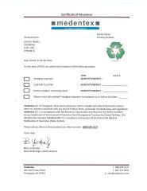
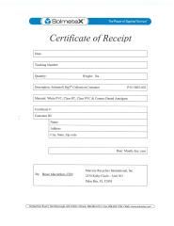
Record Keeping Requirements
  The following documentation must be established and maintained for no less than three (3) years and made available for review upon request from the Metro District.
  Receipts or documentation from recycling or disposal facility of all recycling and disposal shipments of amalgam waste;
  Logs of amalgam waste removed for the vacuum system or plumbing;
  Documentation of maintenance performed on any amalgam separator; and
  Employee training logs.
  (See Example Amalgam Removal Log on next slide.)
Record Keeping Requirements
Slide 24
Notes:
Keep it brief. Make your text as brief as possible to maintain a larger font size.

Slide 25
Operations & Maintenance Plan
Example Amalgam Removal Log
(For amalgam waste removed from the vacuum system or plumbing, amalgam separator maintenance, or other documentation from recycling or disposal facility of amalgam waste recycling and disposal shipments.)
Event Date | Event Type | Employee Name & Signature | Off-Site Vendor | Notes
03/15/15 | Full amalgam separator cartridge returned. | Jane Doe ______________ | ”Mercury Recycling Company XYZ” | Amalgam separator cartridge full. Replaced with new cartridge & sent full cartridge to “Mercury Recycling Company XYZ” for recycling. See waste manifest / recycling receipt.
06/22/15 | Scrap recycling bucket full. | John Doe ______________ | “Mercury Recycling Company ABC” | Secured scrap amalgam bucket and mailed to “Mercury Recycling Company ABC” - See shipping invoice.
08/30/15 | Wet vacuum filter cleaned. | Pat Smith ______________ | N/A | Filter waste emptied into scrap amalgam bucket.
11/03/15 | Chair-side traps replaced. | Jane Doe ______________ | N/A | Disposable chair-side traps placed in scrap amalgam bucket and replaced with new traps.
Record Keeping Requirements
Slide 25
Notes:
Keep it brief. Make your text as brief as possible to maintain a larger font size.

Slide 26
Annual Requirements and Inspections
Metro District Rules and Regulations 6.25
Slide 26
Notes:
Use a section header for each of the topics, so there is a clear transition to the audience.

Slide 27
Annual Requirements and Inspections
  Right of Entry –
    The Metro District may conduct inspections of the facility and examine and copy any records required to be maintained by this facility to determine compliance with the conditions of our Rules and Regulations.
  Inspections –
    Metro District staff may perform an inspection at your facility to verify compliance with the Metro District’s Dental Amalgam Control Program.
    Inspection components include:
      Amalgam separator(s) and related plumbing, as well as chair-side traps and vacuum pumps.
      Implementation of Best Management Practices.
      Verify type of amalgam used. Bulk mercury must not be used.
      Spill prevention and control procedure to protect from accidental discharge.
      Maintenance records and waste manifests.
Annual Requirements and Inspections
Slide 27
Notes:
Keep it brief. Make your text as brief as possible to maintain a larger font size.

Slide 28
Annual Requirements and Inspections
(Continued)
  Inspections – (Continued)
      Employee training logs.
      Program Advisor posted in a prominent location in the office.
      Use of only non-chlorine or non-oxidizing (neutral) cleaners.
      Any other processes with discharge to the sanitary sewer.
  Noncompliance –
    Noncompliance with the conditions of the Metro District’s Rules and Regulations may subject the facility to enforcement action as deemed appropriate by the Metro District.
  Looking Forward –
    In accordance with the Metro District’s Rules and Regulations, dental facilities will be required to certify BMPs, Amalgam separators and O&M plans annually. Additionally, facilities can expect to be occasionally inspected to verify paperwork, certifications and overall compliance.
Annual Requirements and Inspections
Slide 28
Notes:
Keep it brief. Make your text as brief as possible to maintain a larger font size.

Slide 29
Quiz #2
Slide 29
Notes:
Use a section header for each of the topics, so there is a clear transition to the audience.

Slide 30
Quiz #2
  Amalgam separators must comply with ISO 11143 standards and be designed with a minimum removal of:
    98% Solids
    85% Solids
    50% Solids
  Amalgam separator compliance certifications that the separator has been properly used and maintained must be submitted:
    Monthly
    Never
    Annually
  Amalgam separators must be installed, operated, maintained and properly sized for the volume and flow of the dental facility’s amalgam wastewater according to:
    The government.
    The manufacturer’s specifications and recommendations.
    The ADA
Quiz #2
Slide 30
Notes:
Keep it brief. Make your text as brief as possible to maintain a larger font size.

Slide 31
Quiz #2
(Continued)
  An O&M plan requires the following monthly procedure:
    Visual inspection of the amalgam separator(s).
    Inspection log updated with date and personnel signature.
    All of the above.
  Collection devices must be replaced:
    Per the manufacturer’s recommendation.
    When the solids reach the “full” line.
    All of the above.
  Documentation must be established and maintained for no less than three (3) years for the following:
    Recycling or disposal facility receipts or documentation.
    Logs of amalgam waste removed from the vacuum system or plumbing.
    Documentation of maintenance performed on any amalgam separator.
    Employee training logs.
    All of the above.
Quiz #2
Slide 31
Notes:
Keep it brief. Make your text as brief as possible to maintain a larger font size.

Slide 32

Contact Information:
Scott Caldwell Suzanne Renter
Amalgam Control Program Investigator Amalgam Control Program Investigator
Phone: 303-286-3182 Phone: 303-286-3128 scaldwell@mwrd.dst.co.us srenter@mwrd.dst.co.us
Lori Maag
Industrial Waste Supervisor
Phone: 303-286-3434 lmaag@mwrd.dst.co.us
Thank You!
Slide 32
Notes:
Use a section header for each of the topics, so there is a clear transition to the audience.

